Slide 2
Button
Div na magiging modal
javascript

Slide 4
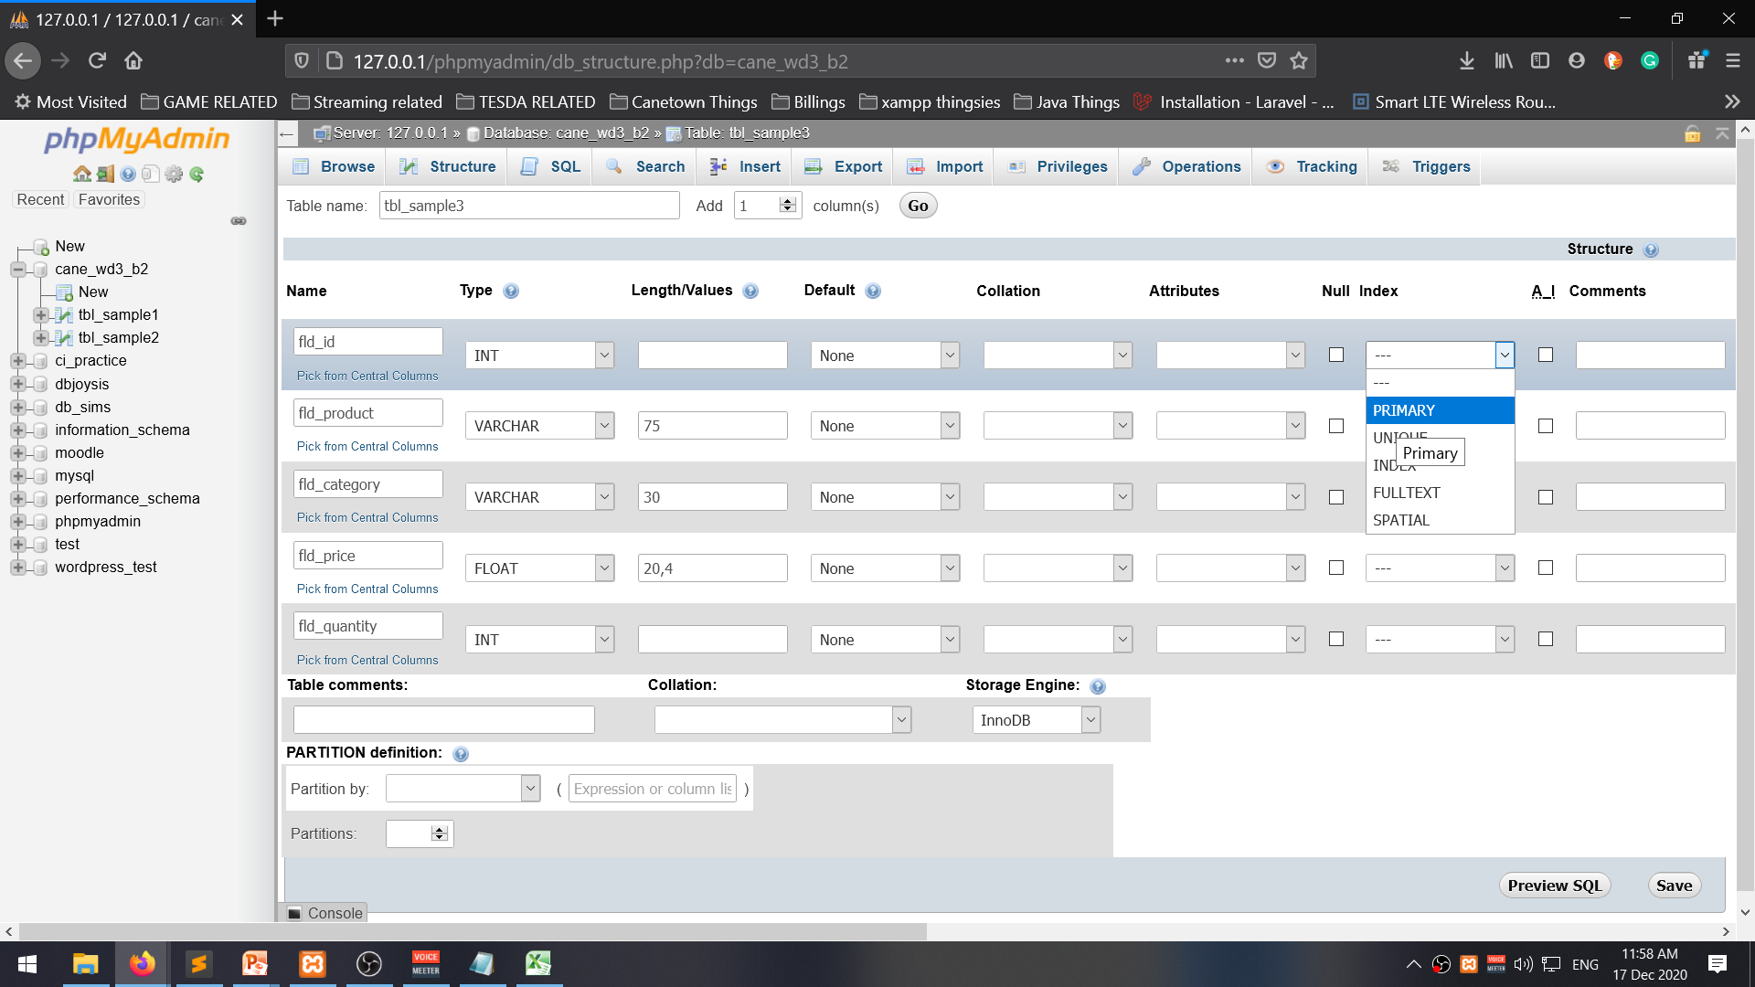

Slide 5
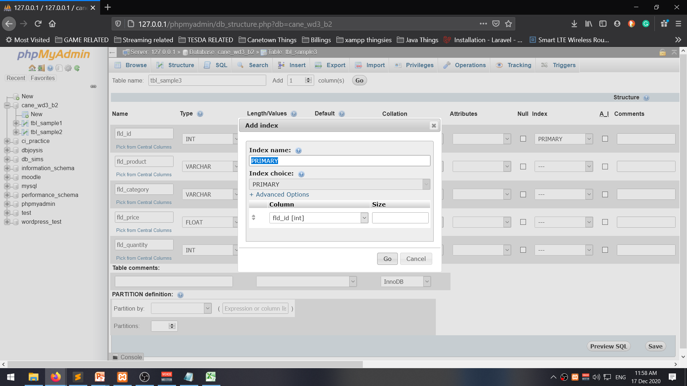

Slide 6
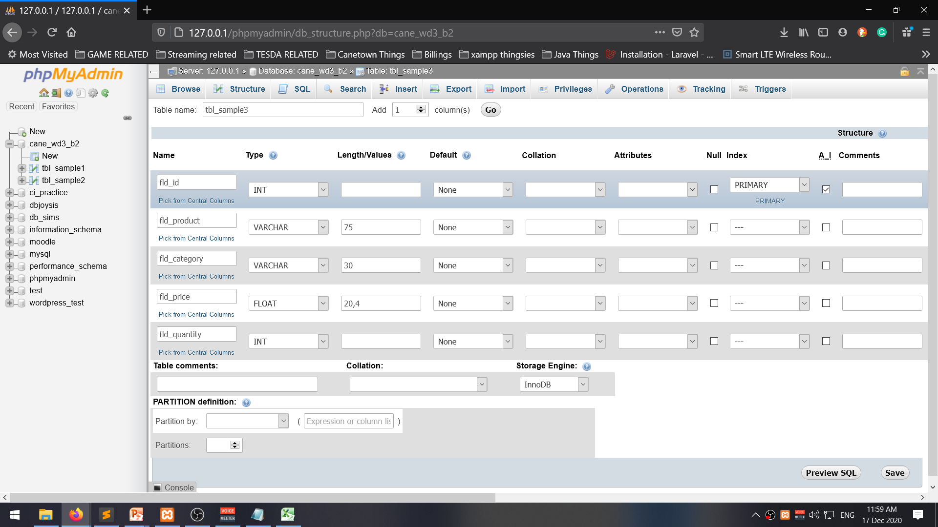
ai = Auto-Increment

Slide 7
User check
n
y
Pass check
n
y
WHERE fld_user = ‘__’ a AND fld_pass = ‘___’

Slide 8
Buying a list of products
Product list
Get list
Get next product on list
Is product available
n
y
Buy product,
record bought
Is that last on list
n
y
Show record bought

Slide 9
Monito monita requirements
Fld_color = red
Fld_taste = sweet
Fld_Price >=50
gift
Choose gift
Is gift >= 50
n
y
Is gift red?
Is gift sweet?
n
n
y
y
Give gift
fld_color=‘red OR fld_taste=‘sweet’ AND fld_price >= 50

Slide 10
Customer list
Product list
Order list
Product inventory

Slide 11
Odd or even
$num, $rem, $group
$num = __
$rem = $num % 2
Is $rem = 0?
n
$group = odd
y
$group = even
echo “$num is an $group number“;

Slide 12
$num1, $num2, $res
$num1=__, $num2=__, $op
$res = $num1 + $num2;
Echo “$num1 + $num2 = $res”;

Slide 13
$n1, $n2, $n3, $largest
Compare 3 numbers
Get largest number
$n1=_, $n2=_, $n3=_
Is $n1 > $n2?
n
$largest = $n2
y
$largest = $n1
Is $largest < $n3?
n
y
$largest = $n3
echo "The largest number is $largest"

Slide 14
Scenario: Crossing the road
Do you look left or right before crossing
n
y
High chance of accident
You cross the road safely

Slide 15
Is $direction == “up”
n
y
Count down code
Count up code

Slide 16
Is $numstart < $numEnd
Is $numstart > $numEnd
n
n
y
y
Count up from $numStart to $numEnd
Count down from $numStart to $numEnd
Echo “numbers are same”

Slide 17
Primary key, Title, Content, Date

Slide 18
New post
update
delete
update
delete
update
delete
Primary key, Title, Content, Date

